Slide 1
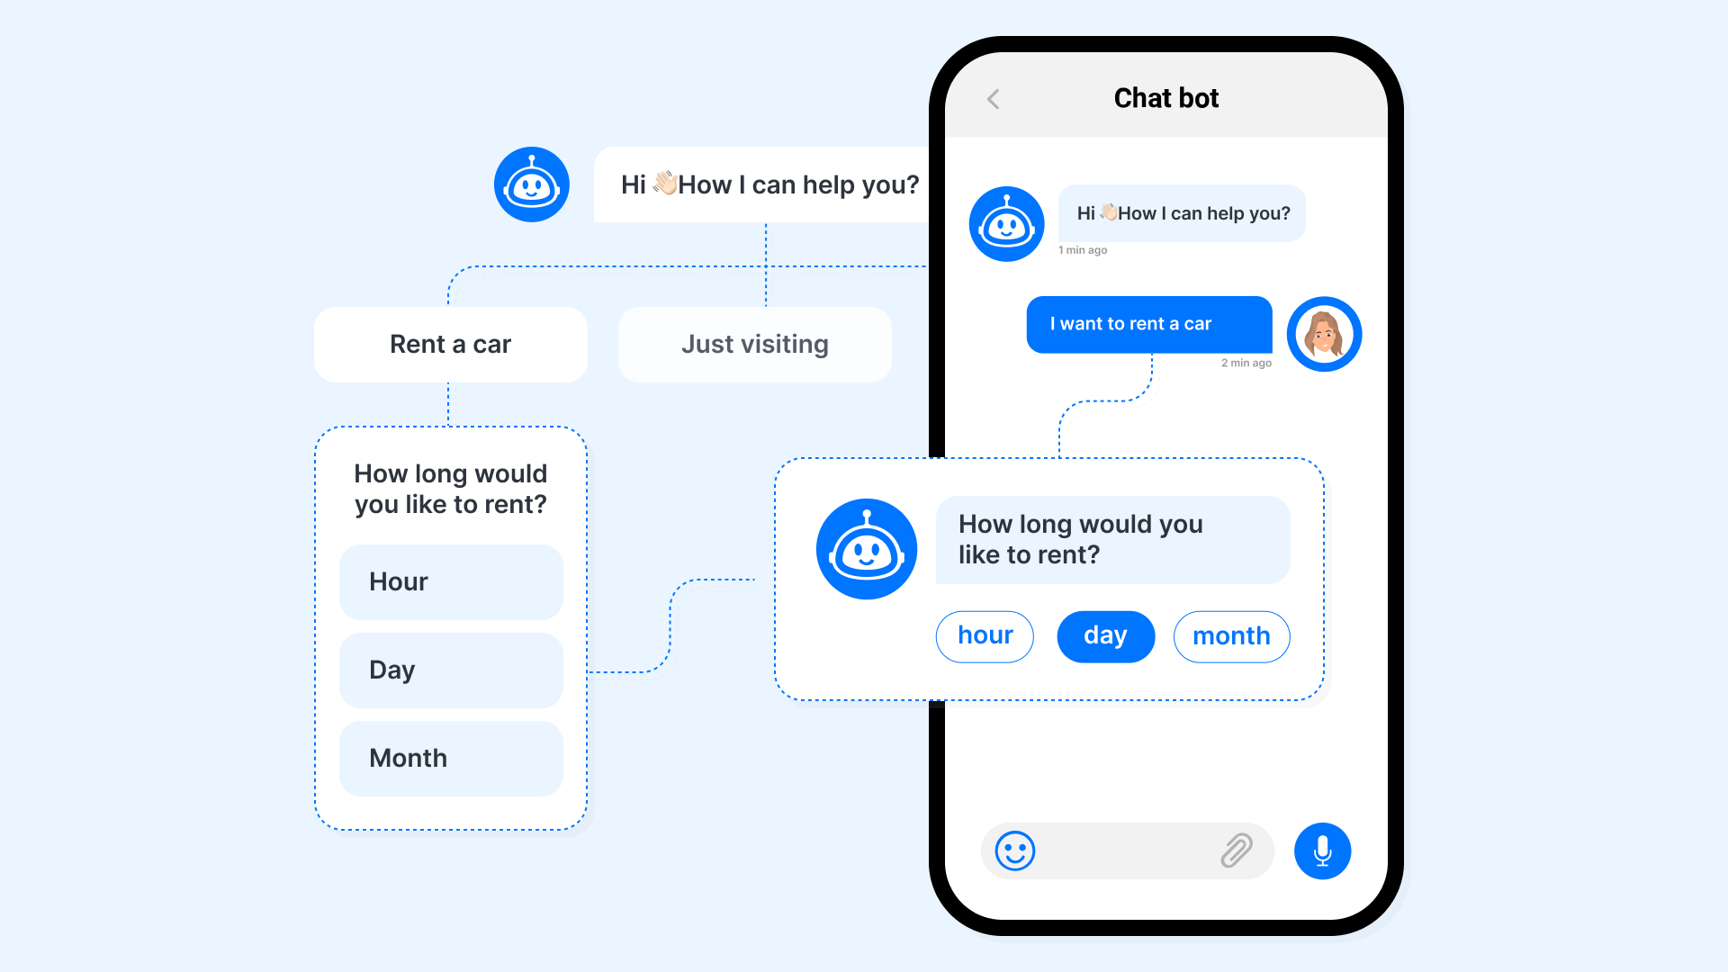
Teaching Assistant Bot Univ.AI | AI – 3 Project
Problem Statement
Teaching Assistant Bot
Chatbots are one of the most popular applications of Natural Language Processing. For the scope of this project, we will focus on creating a user-friendly tool that helps the Teaching Staff automatically answer questions posed by students on a forum.
The core problem we are trying to solve is to help answer questions that are frequently asked by students in a learning setup. We are not looking for a bot that is capable of answering extremely specific and one-of-a-kind questions. The idea is to reduce the load from the TAs but dealing with questions that are repetitive and whose response does not change in different scenarios.
Team Chappie : Abhineet Sharma, Raghav Sahni, Lokadithya Reddy and Adarsh Roy

Slide 2
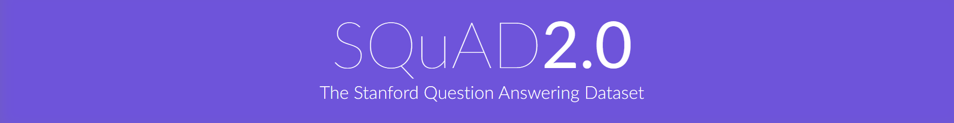
What is SQuAD?
Stanford Question Answering Dataset (SQuAD) is a reading comprehension dataset, consisting of questions posed by crowdworkers on a set of Wikipedia articles, where the answer to every question is a segment of text, or span, from the corresponding reading passage, or the question might be unanswerable.
SQuAD2.0 combines the 100,000 questions in SQuAD1.1 with over 50,000 unanswerable questions written adversarially by crowdworkers to look similar to answerable ones. To do well on SQuAD2.0, systems must not only answer questions when possible, but also determine when the paragraph supports no answer and abstain from answering.

Slide 3
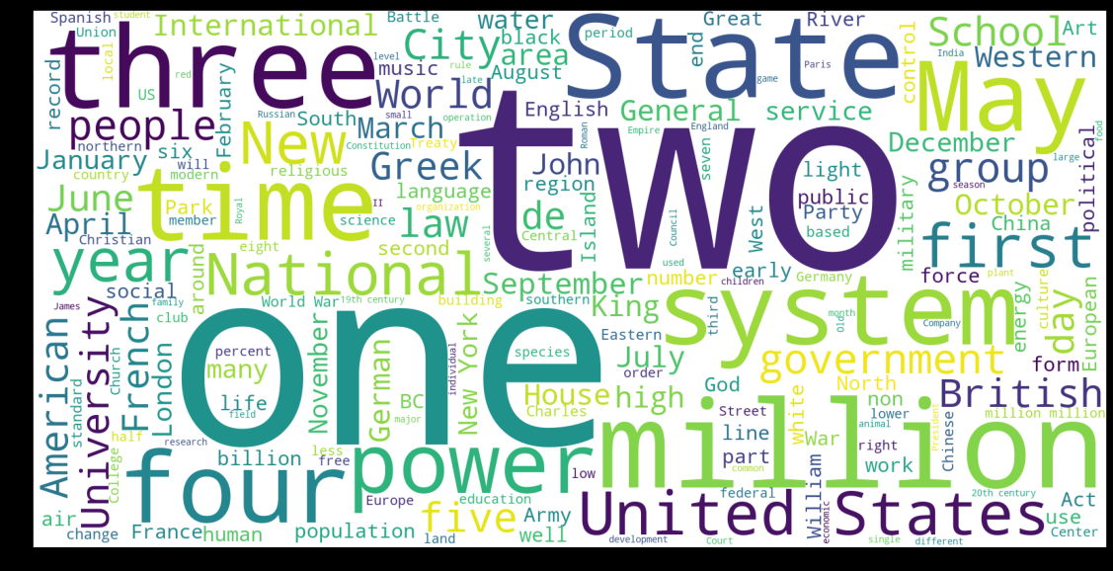
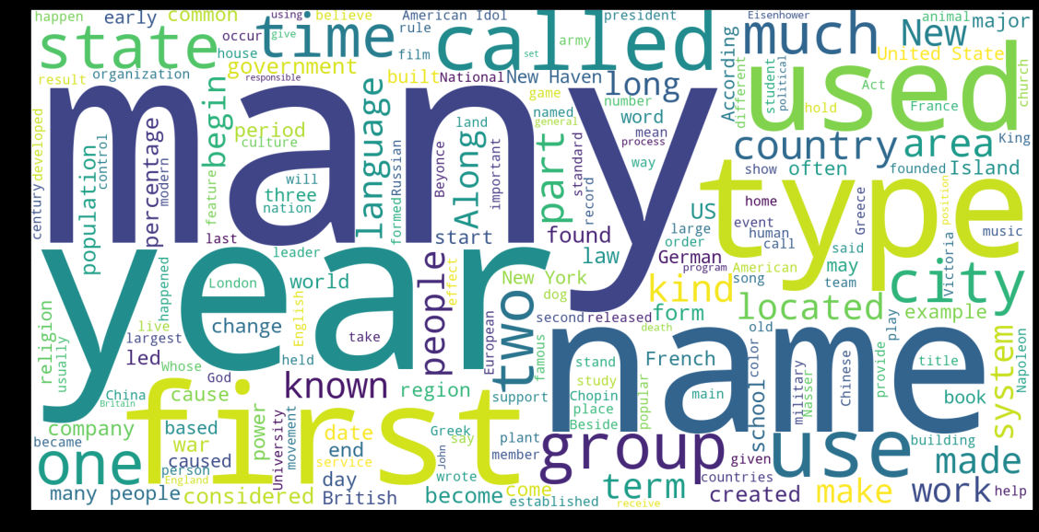
Data Cleaning and Visualization
We Used libraries like NLTK and spaCy for the cleaning and visualization of the Text data.
Answer Word Cloud
Question Word Cloud

Slide 4
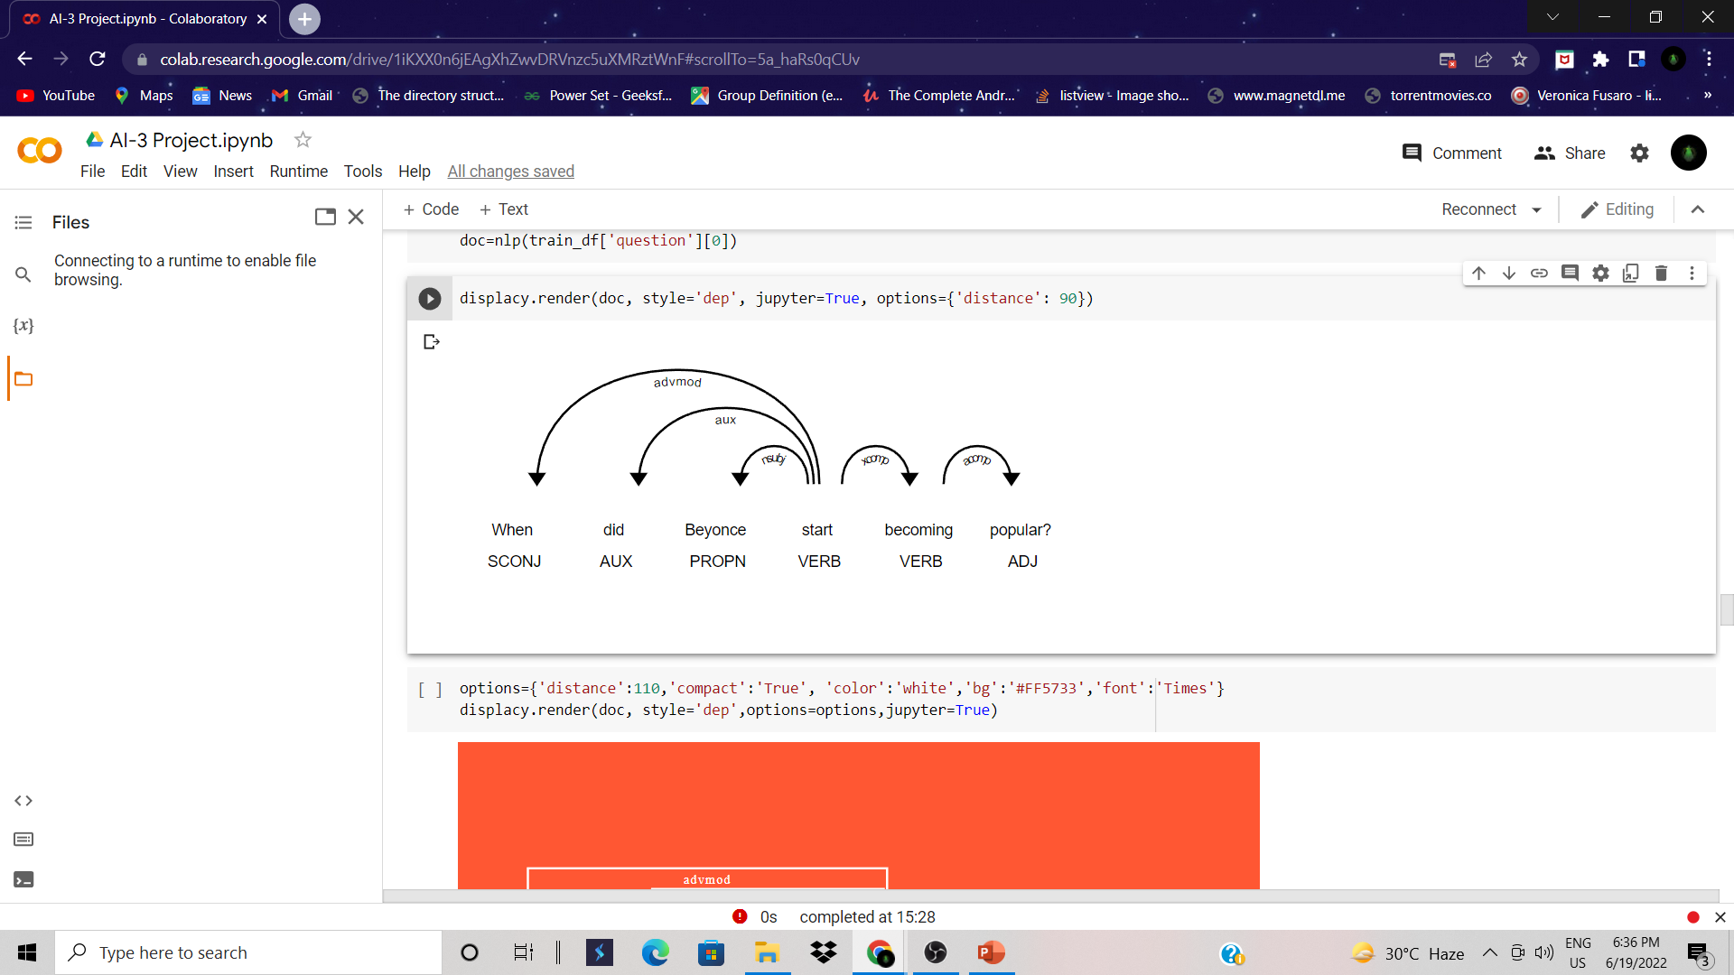
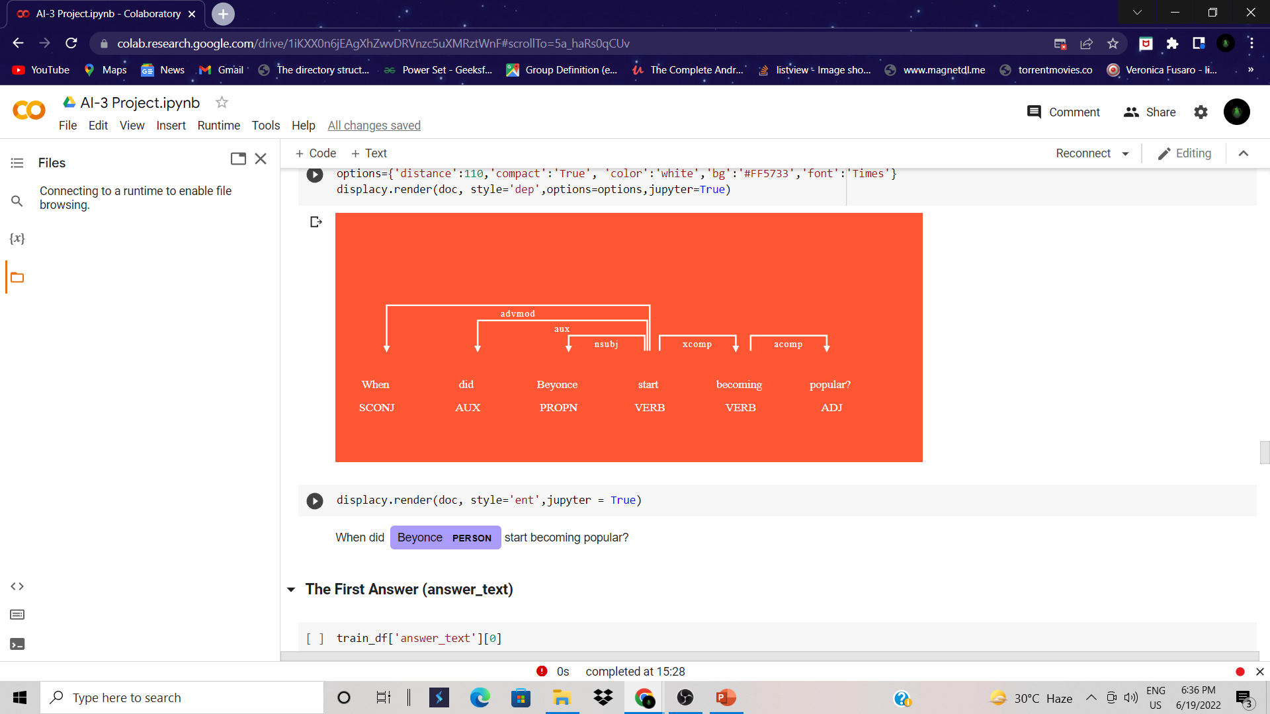
Analysis of the First Question
The First Question : When did Beyonce start becoming popular?
Here, the entity relationships are being defined along with their identification

Slide 5
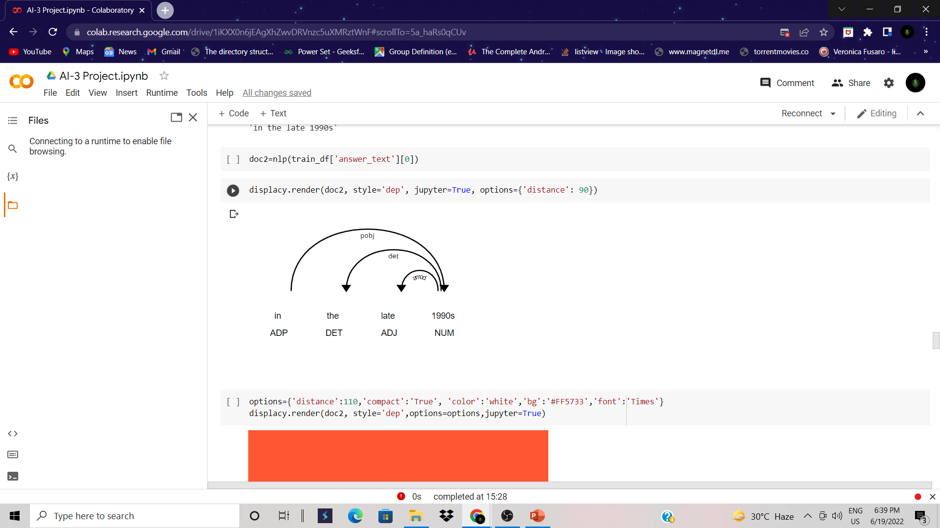
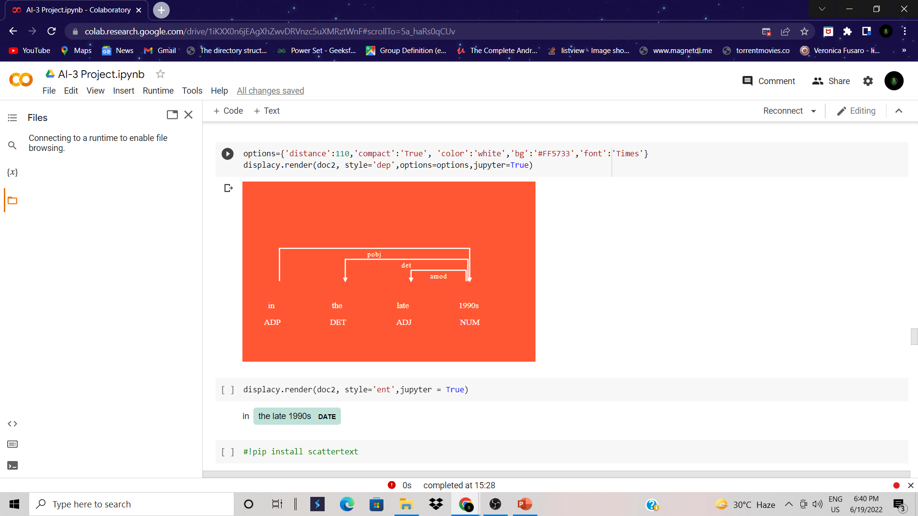
Analysis of the First Answer
The same was done for the “answer_text” field of the DataFrame
Here as well, the entity relationships are being defined along with their identification

Slide 6
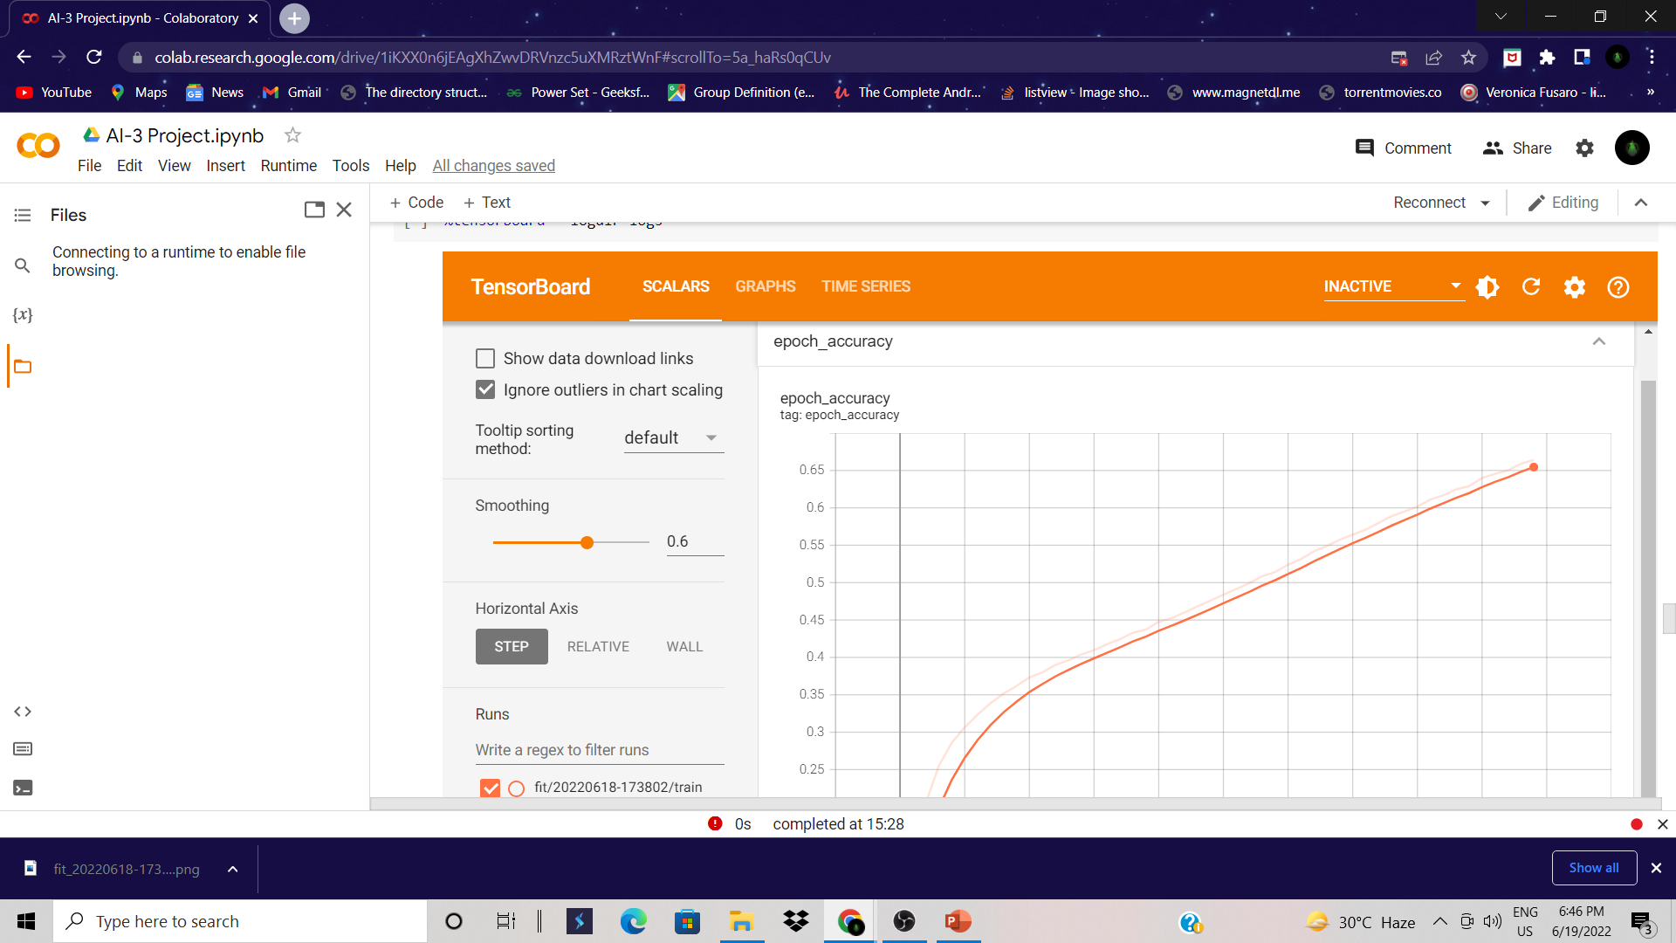
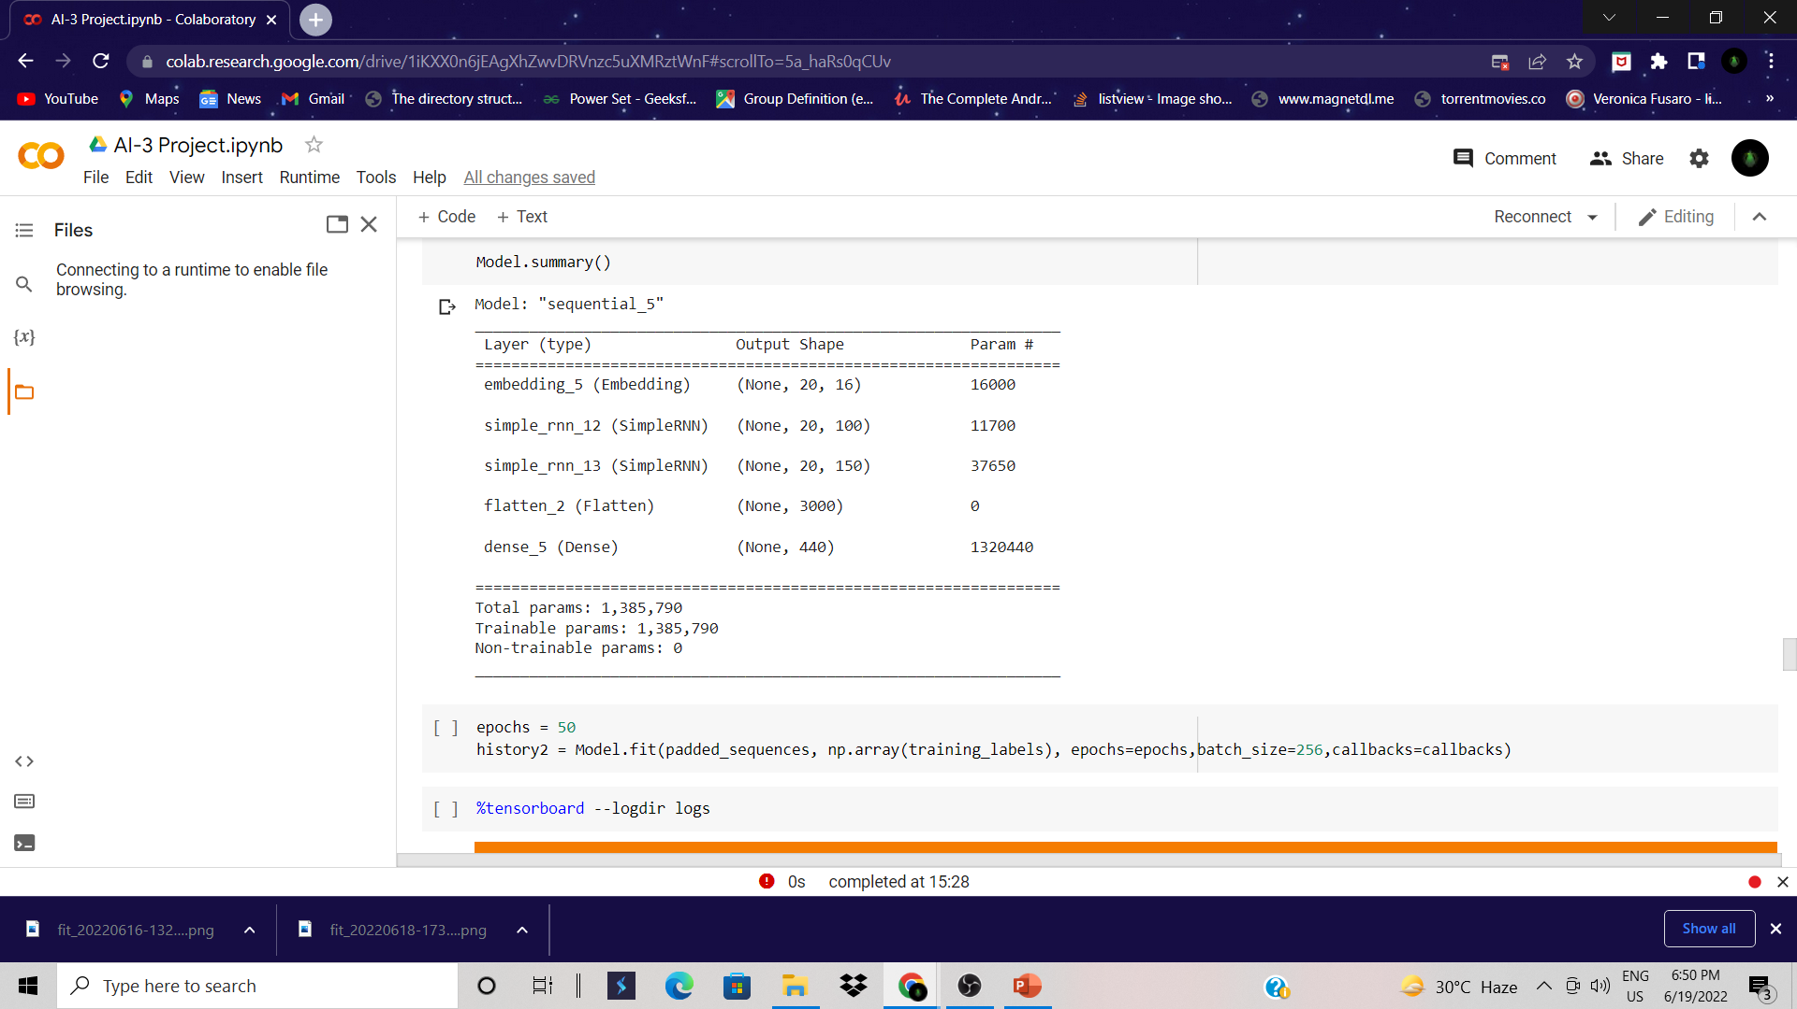
The Baseline Model
The Model Ran a total of 50 epochs and had a train Accuracy of 66.41%
The Architecture included 2 SimpleRNN layers as mentioned in the Problem Statement
Model Summary

Slide 7
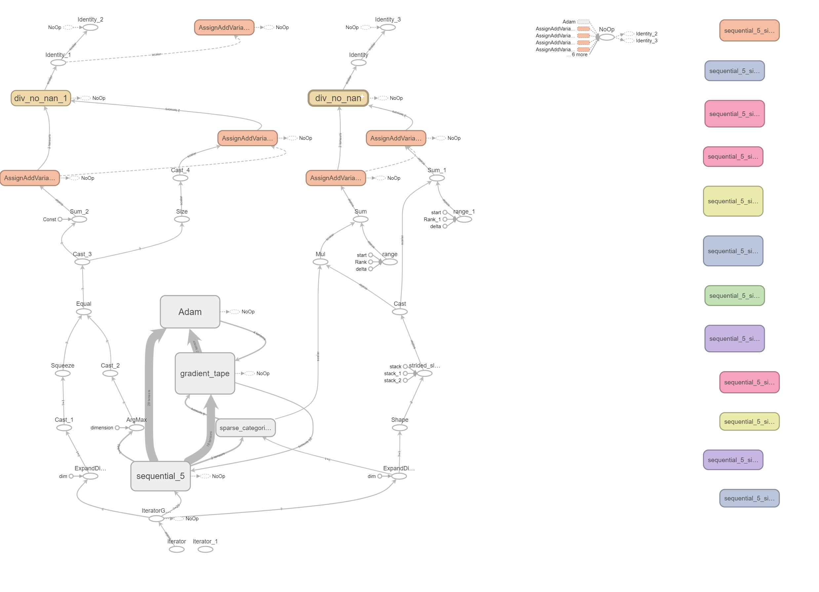
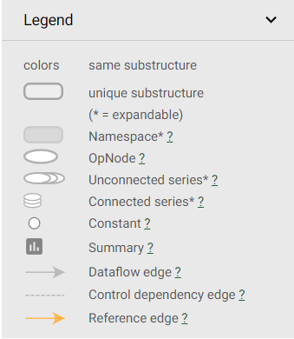
Model Graph

Slide 8
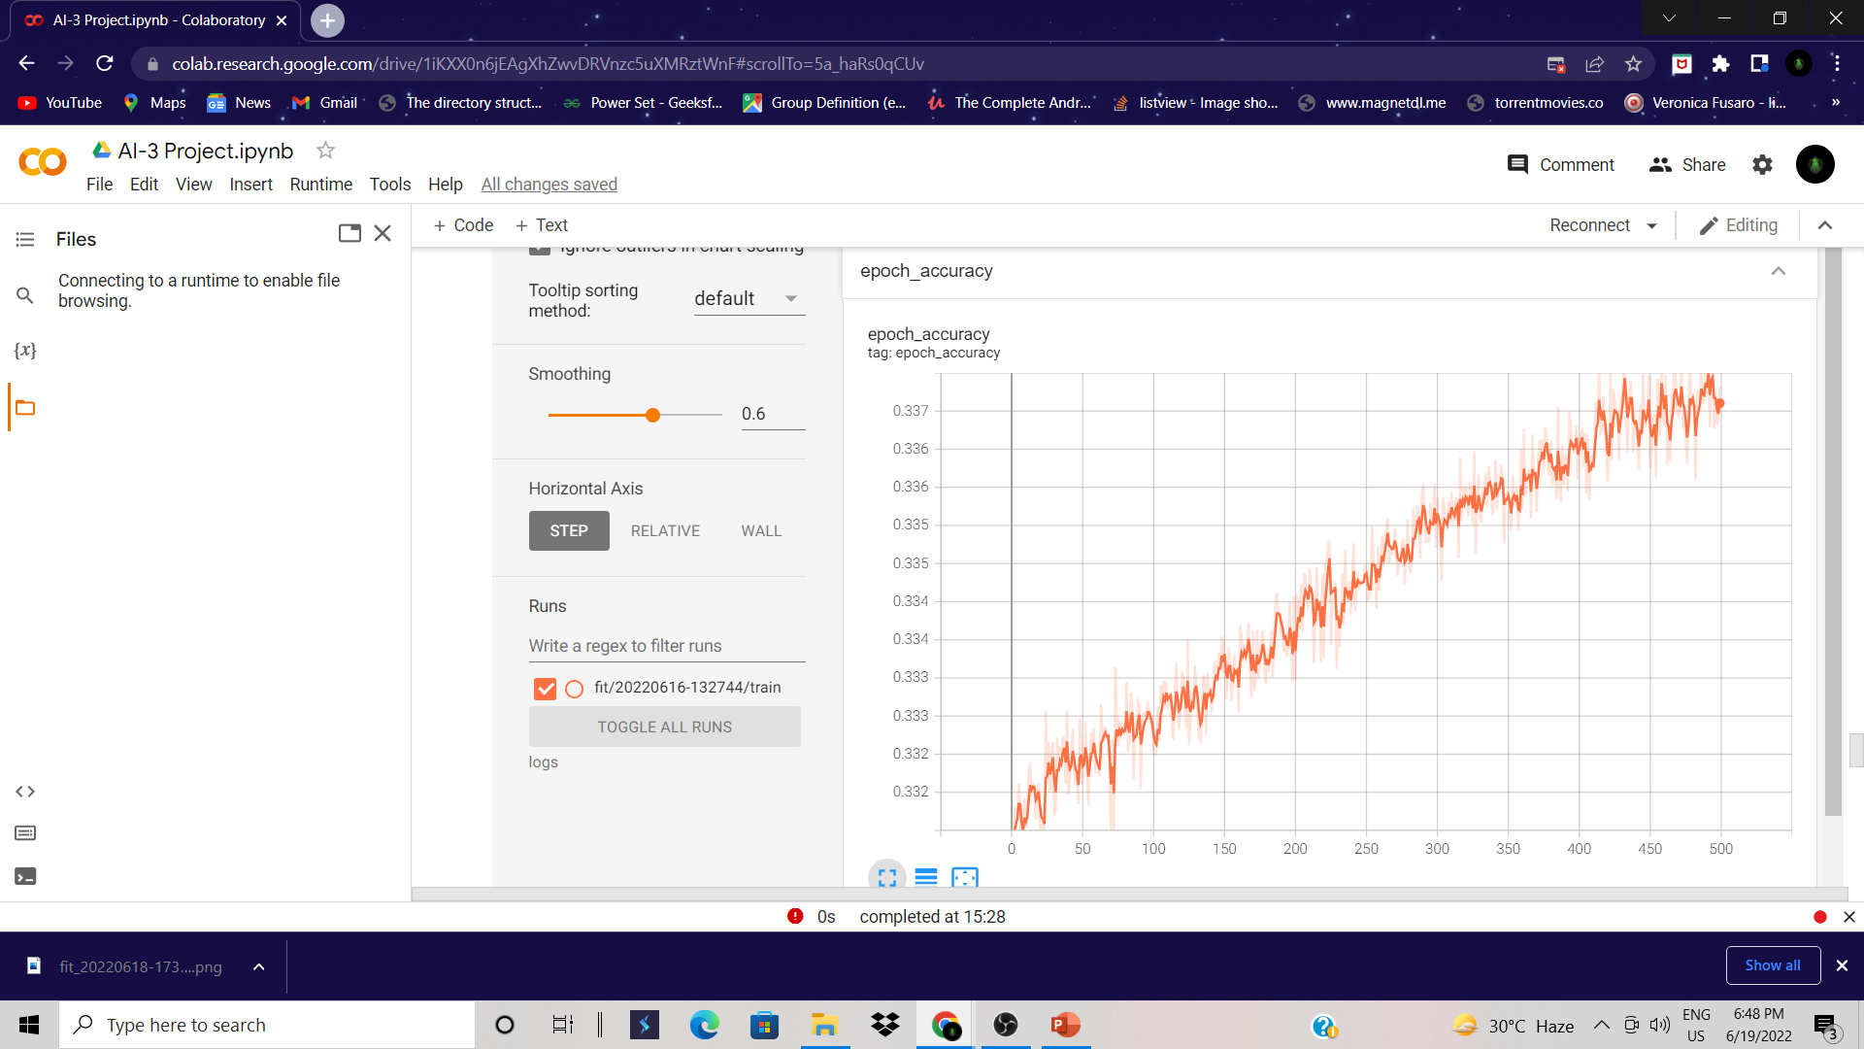
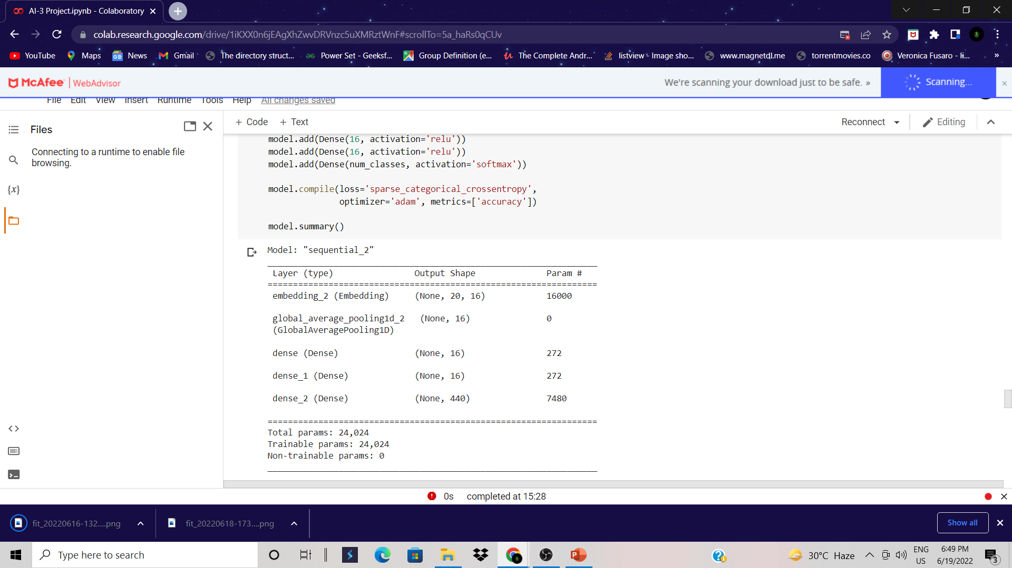
The Deep Learning Model (No RNN Layers)
Another Deep Learning Model was made for reference that had no SimpleRNN Layers and the Accuracy was 33.4%.
Model Summary

Slide 9
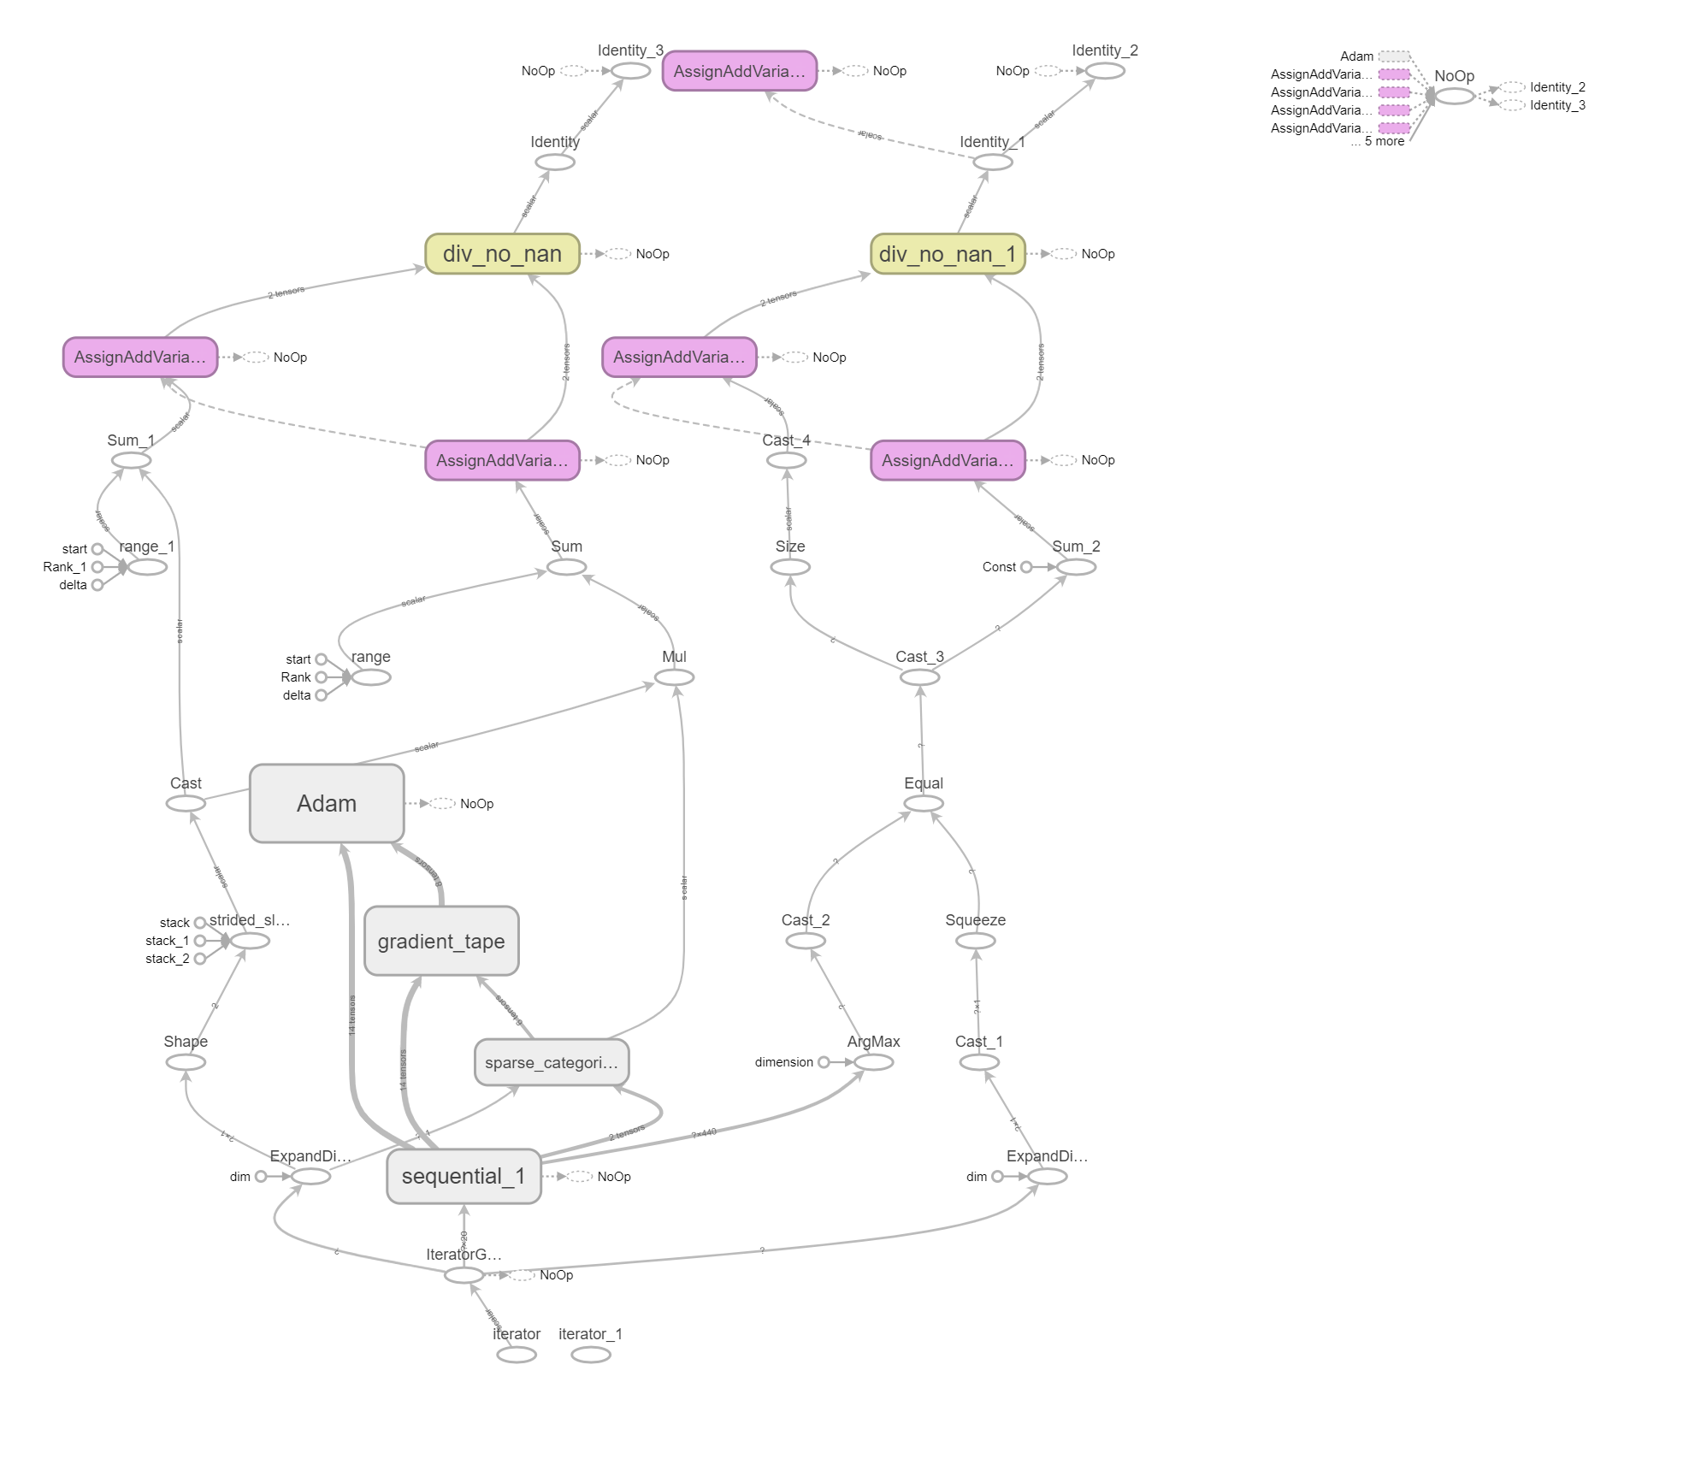
Model Graph

Slide 10

Why BERT ?
BERT, which stands for Bidirectional Encoder Representations from Transformers, is based on Transformers, a deep learning model in which every output element is connected to every input element, and the weightings between them are dynamically calculated based upon their connection. (In NLP, this process is called attention.)
Historically, language models could only read text input sequentially -- either left-to-right or right-to-left -- but couldn't do both at the same time. BERT is different because it is designed to read in both directions at once. This capability, enabled by the introduction of Transformers, is known as bi-directionality.
Using this bidirectional capability, BERT is pre-trained on two different, but related, NLP tasks: Masked Language Modeling and Next Sentence Prediction.

Slide 11

Thank You

